Slide 1
Agricultural Communications: How to use Interdisciplinary Lesson Plans and Digital Storytelling to Engage Students in Science
Dr. Rebecca Swenson
Dr. Garrett Steede
Dr. Troy McKay
Notes:
Intro
Ov

Slide 2
Why is Agricultural Communications Important?
Good communication skills are important life skills
Good communication skills are important for two parts of the 3-circle model.
FFA
Supervised Agricultural Experiences
FFA
Creed Speaking, Extemp./Prepared Public Speaking, Chapter Conducting, Employment Skills, Ag Comm CDE, & Ag Marketing CDE
SAEs
“A key component of quality SAE is documentation…”
Notes:
GS: From National FFA’s Philosophies & Guiding Principles of SAE Document: “A key component of quality SAE is documentation which includes not only financial recordkeeping but also a record of skills and knowledge attained, credentials or certifications earned evidence of prior planning, evidence of reflection and evidence of career planning.”
Good Communication skills are important for two of the three circles in the model, so the most logical place for the foundations of good communication to be taught is in the third circle: Classroom/Laboratory Instruction

Slide 3
A WHOLE course for Ag Comm?
Maybe!
If not a whole course, then what can you do?
Teach good communication skills in your classroom
Use assignments to allow students to practice their communications skills
Let your classes help you train more than one team
“I’m busy”
“I already have my curriculum”
“I don’t know enough to formally teach ag comm”
Notes:
GS: What are your student needs/interests? What are your strengths? How might an ag comm course strengthen your program as a whole? Could it help meet a state requirement for your students? Encourage non-traditional students to be a part of your program? IF starting/developing an ag comm course is something you’re interested in, then we would LOVE to help connect you with others who are teaching ag comm in other states.
Maybe these are some of the reasons you haven’t taught ag comm yet or maybe they are keeping you from trying to teach ag comm in your formal classroom. For the first part of this session, we want to talk to yall about how you can incorporate ag comm curriculum directly into your current classrooms, but first, Rebecca is going to show you how ag comm is being incorporated in other places.

Slide 4
Incorporating Ag Comm in other places
Digital media is a powerful tool for learning in all science classrooms.
growing segment of jobs
teach key communication skills
engage students in new and creative ways
Video: https://youtu.be/spqwrsVQNWk
Notes:
rs

Slide 5
Overview of all Lessons (RS)
Animal Nutrition
Animal Welfare
Careers in AFNR
Plant and Animal Genetics
Plant Nutrition
Dairy Lifecycle
GMOs
Find these and additional resources on:
www.umnagricast.com
Notes:
RS - show website

Slide 6
Dairy Lifecycle/Ag Advocacy using Fact Sheets
Lifecycle of a dairy cow from calf to cow
Concerns consumers might have about animal welfare at each stage of a dairy cow’s life
Media Miscommunication
Fact Sheets
https://drive.google.com/open?id=1Lp4_AkYOztn2hjLIh6b4UjJwUVF0YQi5
Notes:
GS Hailey

Slide 7
Teaching Plant Nutrition with Informative Speech Principles
Prompts for classroom discussion
Plant nutrition slideshow
(essential nutrients, limiting nutrients, nutrient deficiency
Classroom activity
(roleplay UMN Extension NM team to create 5-7 minute informative speech outlining fertilizer application plan and Q&A session for a specific audience, including corn growers, soybean producers, sugarbeet farmers, wheat growers).
(after delivering to classmates as a team, peer review/vote on best informative content, speech, and Q&A)
Resources: lesson plan, PPT to use in class, scenario outline handout, rubric, helpful links for more info on communication principles
Notes:
RS
Created by? Audrey

Slide 8
Genetics/Principles of Design
History or DNA, genetics, and biotechnology
Genotype/Phenotype
Vocabulary
Punnett Square
Animal and Plant Examples
People are visual learners
Principles of good design
Infographic
https://drive.google.com/open?id=1SmbQJJaSlyNnoUgSjMw4H2p0szQKwRFc
Notes:
SOCIAL MEDIA BONUS! Also includes a “Tweets by Watson, Crick, and Mendel” activity
Joe

Slide 9
Exploring Careers in Ag using Digital Writing
Introduction: A world without ag activity
Presentation with content on eight AFNR career pathways; Quiz; Application activity
Communication activities:
[Informative] Blog writing - roleplay HS guidance counselor
[Persuasive] Social media writing - roleplay recruiter
Wrap-up activity: 5 finger model
Resources:
Lesson plan, PPT to use in class with career info plus tips on blog writing and social media writing, helpful links document with additional communication content, templates and instructions for creating profiles
Notes:
RS - joe
AFNR career pathways [Agribusiness systems, animal systems, biotechnology systems, environmental service systems, food products and processing, natural resource systems, plant systems, power/structural/technical systems]
Communication activities:
Blog writing (roleplay HS guidance counselor who must draft blog post for students that gives overview of careers in 2 different pathways, then roleplay meeting with HS student in which you share blog and give overview while peer asks questions. Peer uses rubric to rate guidance counselor).
Social media writing (roleplay recruiter that must develop Facebook profile for an organization that recruits young professionals into that career pathway).

Slide 10
Additional Lessons and Resources...
Careers in AFNR
Plant and Animal Genetics
Plant Nutrition
Dairy Lifecycle
Animal Nutrition - What/why animals eat, essential nutrients for animal health, infographic activity
Animal Welfare - 5 freedoms of animal welfare, virtual farm visit to egg production facilities, letter to editor
GMOs - GMO technologies and applications, regulations, case study on golden rice, digital and social media content
https://agricast.weebly.com/lesson-plans.html
Notes:
RS

Slide 11
The Ag Comm CDE
Several of the lessons we have developed can help prepare your students to compete in the ag comm CDE.
Principles of Design: Web Design & Marketing Plan
Informative Speech: Marketing Plan Presentation
Blog Writing: Opinion Writing
Notes:
By using these lessons, you’re not only helping your students be better communicators, thus helping them improve in the many LDEs that require good communication skills, you are also giving a good foundation for the development of an Ag Comm CDE team.

Slide 12
Ag Comm CDE @ National FFA Convention
Media Plan
Media Plan Presentation
Individual Practicums
Journalistic Writing
Opinion Writing
Web Design
Video Production
Editing Quiz
Communication Quiz
Notes:
Each team is made up of 4 members.

Slide 13
Ag Comm CDE @ State Level
Individual Practicums
Journalistic Writing
Opinion Writing
Web Design
Video Production
Editing Quiz
Communication Quiz
Notes:
The winning team will have access to faculty/students to help them develop their media plan for the national contest. This is common in several states.

Slide 14
Changes at the State Level
Accessibility
Contest is held in conjunction with the UMN Winter Invitational
The winning team will have access to faculty/students to help them develop their media plan for the national contest
Mini-Workshops at the contest
Alternatives can now compete
Notes:
Participation numbers have been stagnant for several years. By moving when the contest is we hope to increase the number of participants.
The media plan is daunting, so we wanted to lower the bar for programs wanting to get their feet wet in ag comm
Mini-Workshops for each of the practicum areas before they compete (did this this year and saw an increase in scores)
Alternatives can compete to see how they like the contest, get a feel for it, etc.

Slide 15
Preparation for the Contest
Goal: Make state contest accessible, strengthen basic communication skills, understand Ag Com as potential academic and career pathway
Pre-contest
Nothing - Deep prep
Share umnagricast.com website with students (overview of content, additional resources, good examples of press conference, practicums, and previous quizzes)
Lesson plans and related sources can help connect classroom activities with CDE activities, especially “Helpful links” documents in each lesson toolkit
AP writing resources
Talk to Troy about digital media tools, software, and resources
Stay connected to our program: https://ag-ed.cfans.umn.edu/
Notes:
RS

Slide 16
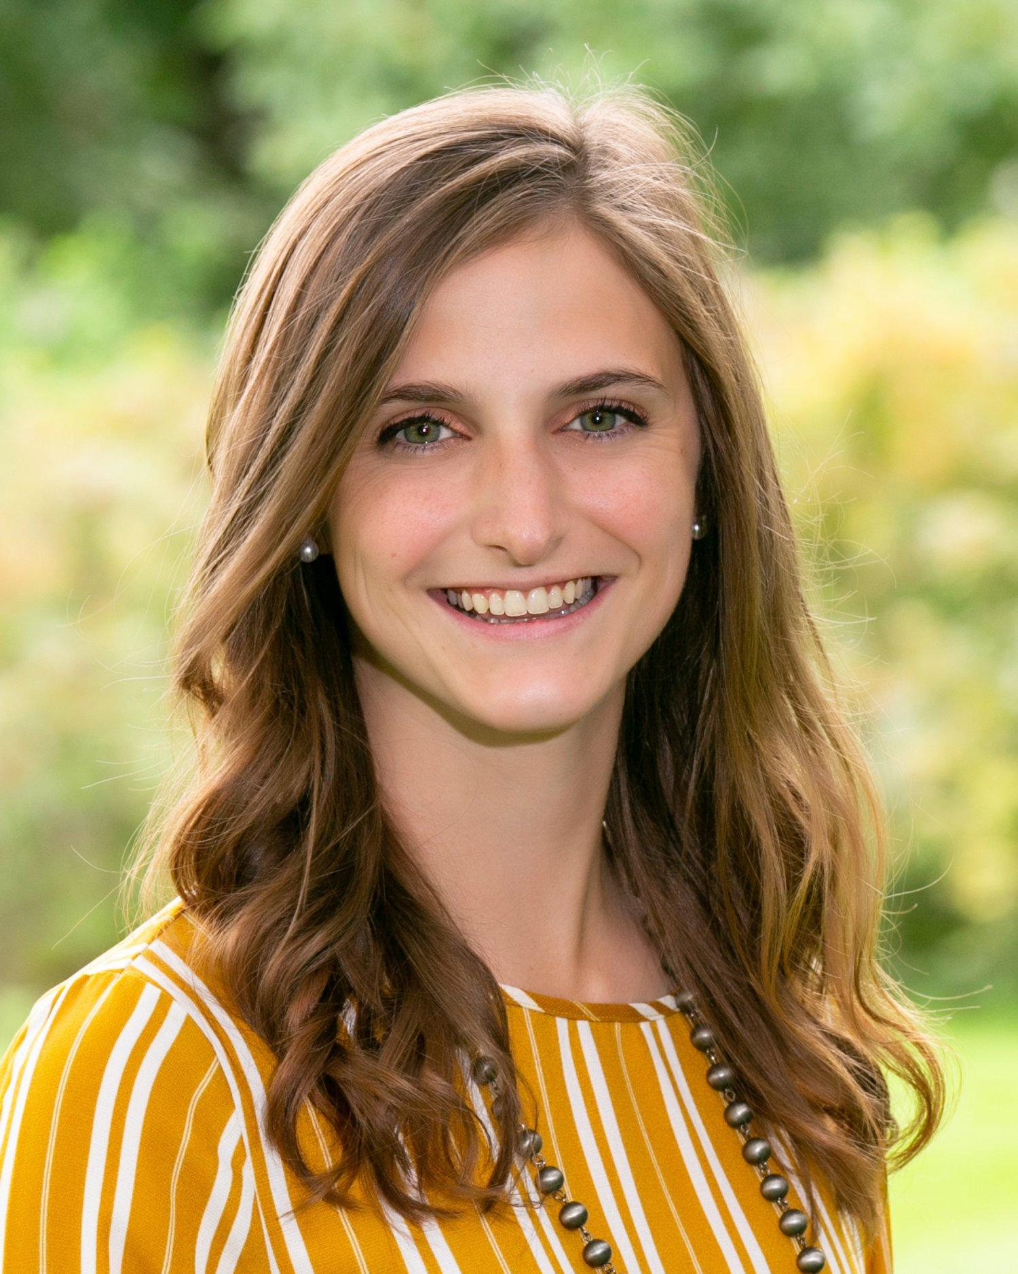
Classroom Visit?
If you would like a classroom visit, please indicate your interest on the sign-in sheet and our Recruitment & Communication Coordinator, Alyssa Groskopf, grosk024@umn.edu
Notes:
RS,
After the break…

