Slide 1
Ag Com CDE 101
University of Minnesota
Agricultural Communications
CDE Invitational Information

Slide 2
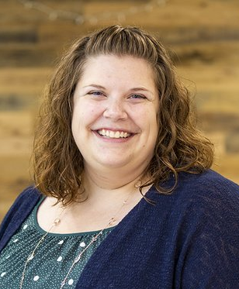
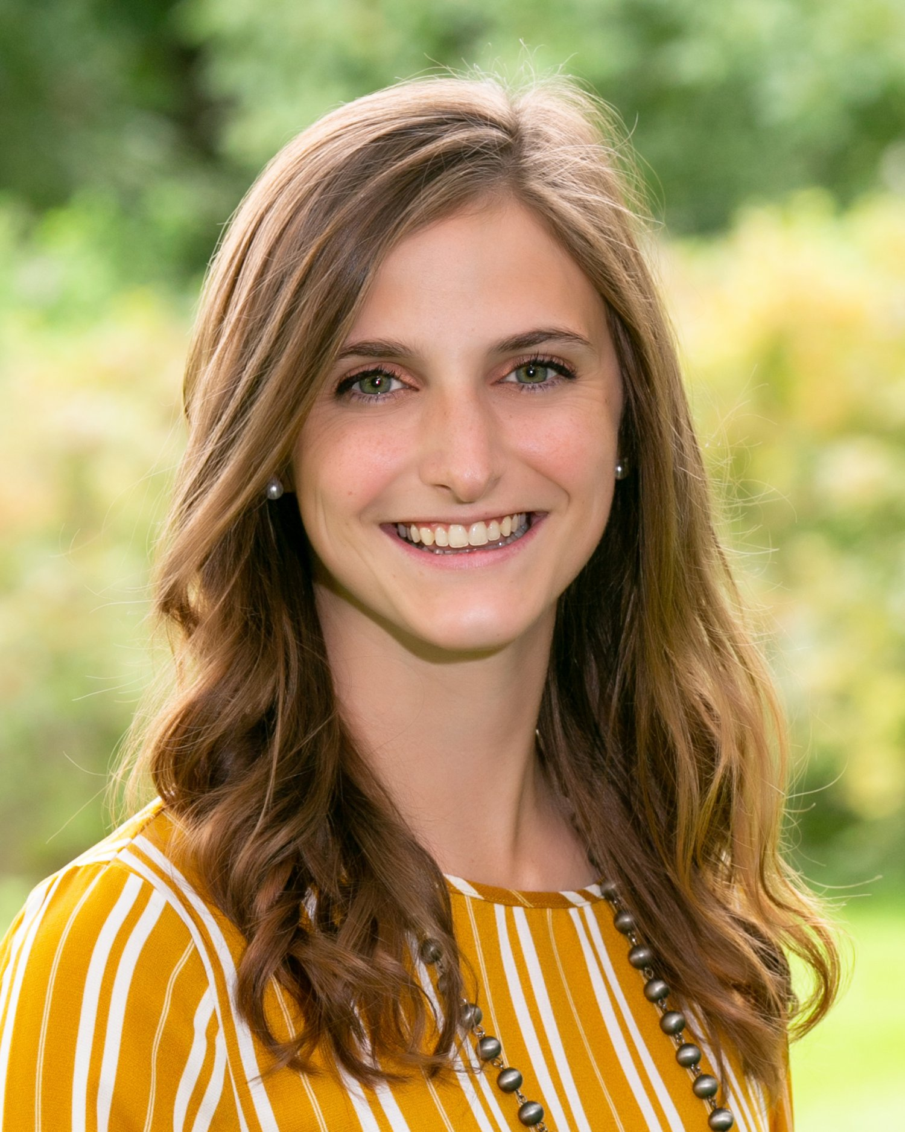
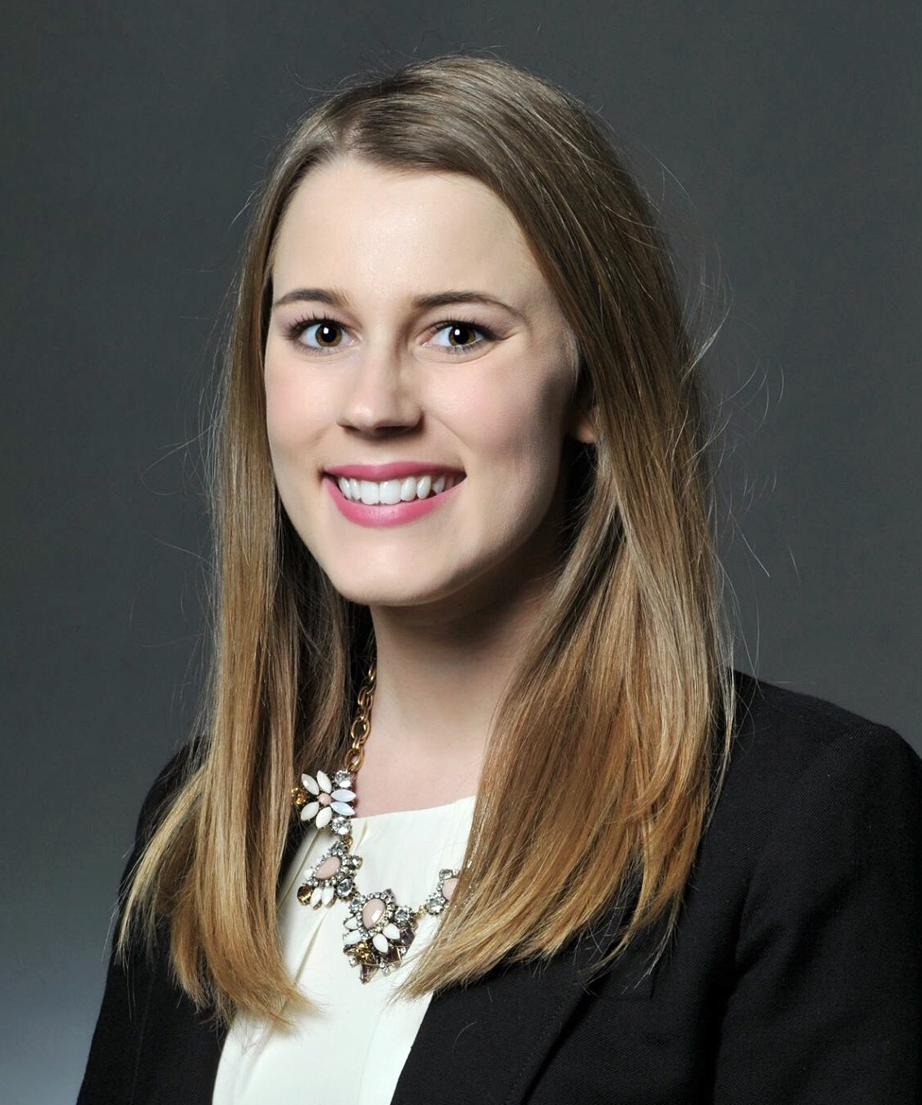
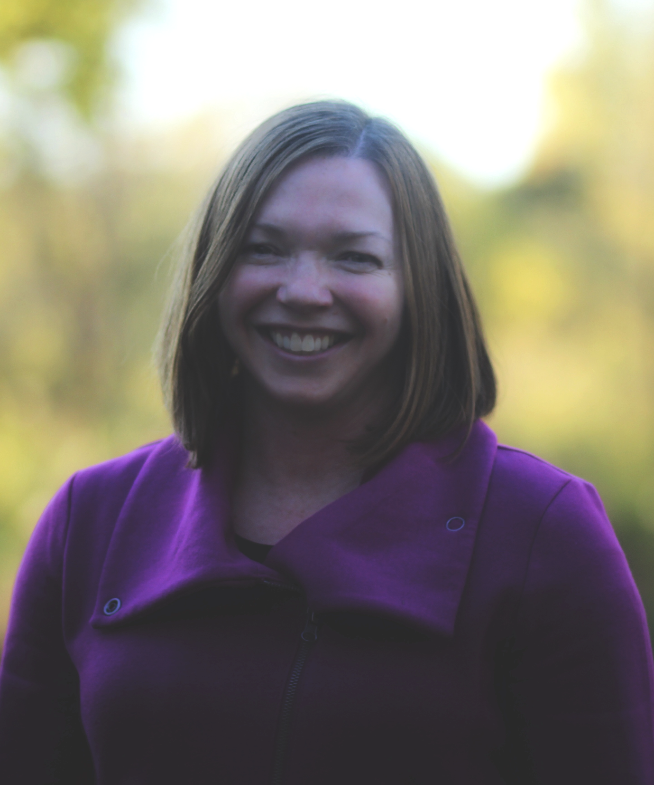
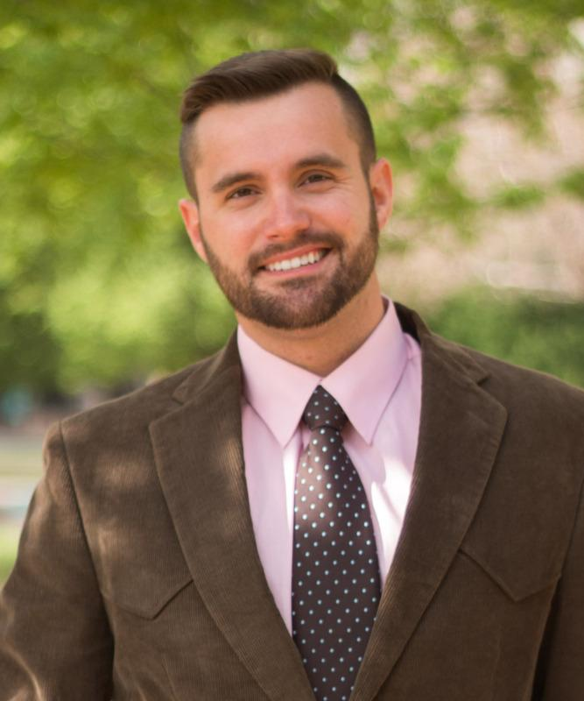
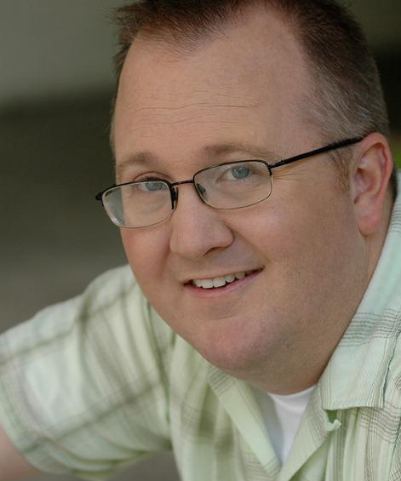
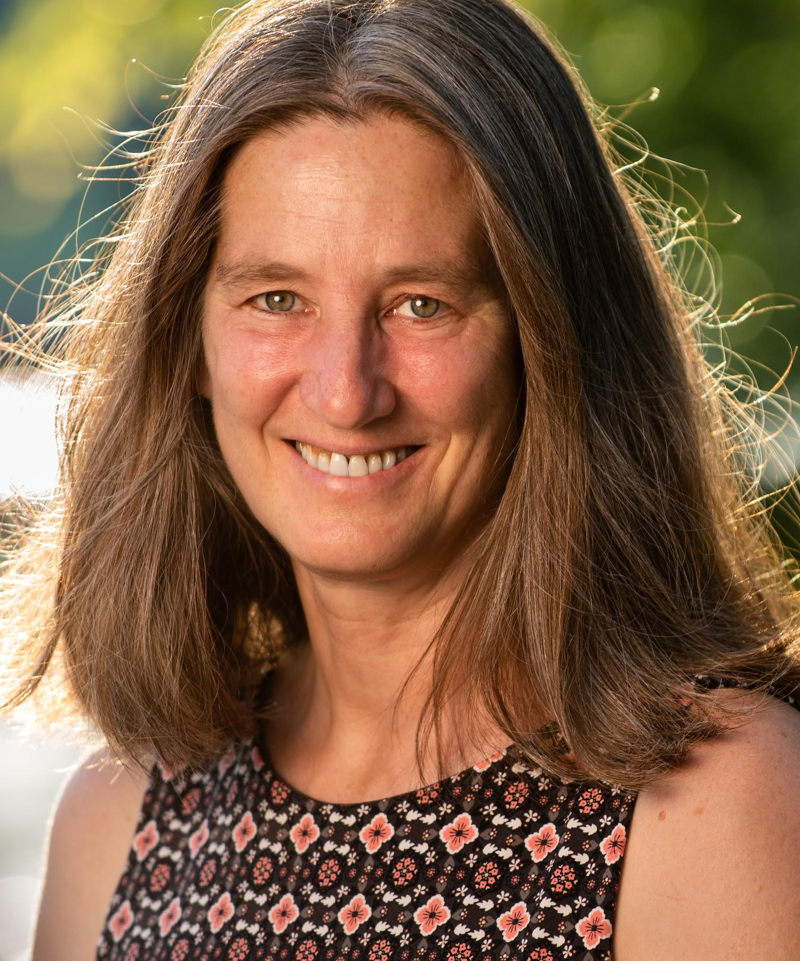
Agricultural Communication & Marketing (ACM) faculty and staff
Sarah Lindholm, Academic Advisor
Michelle Overtoom, Academic Advisor
Alyssa Groskopf, Recruitment & Communications Coordinator
Greta Tank, Project/Program Specialist
Dr. Rebecca Swenson, Associate Professor
Dr. Garrett Steede, Assistant Professor
Dr. Troy McKay, CHS Digital Media Teaching Assistant Professor
Dr. Frances Homans, Department Head
Notes:
Troy

Slide 3
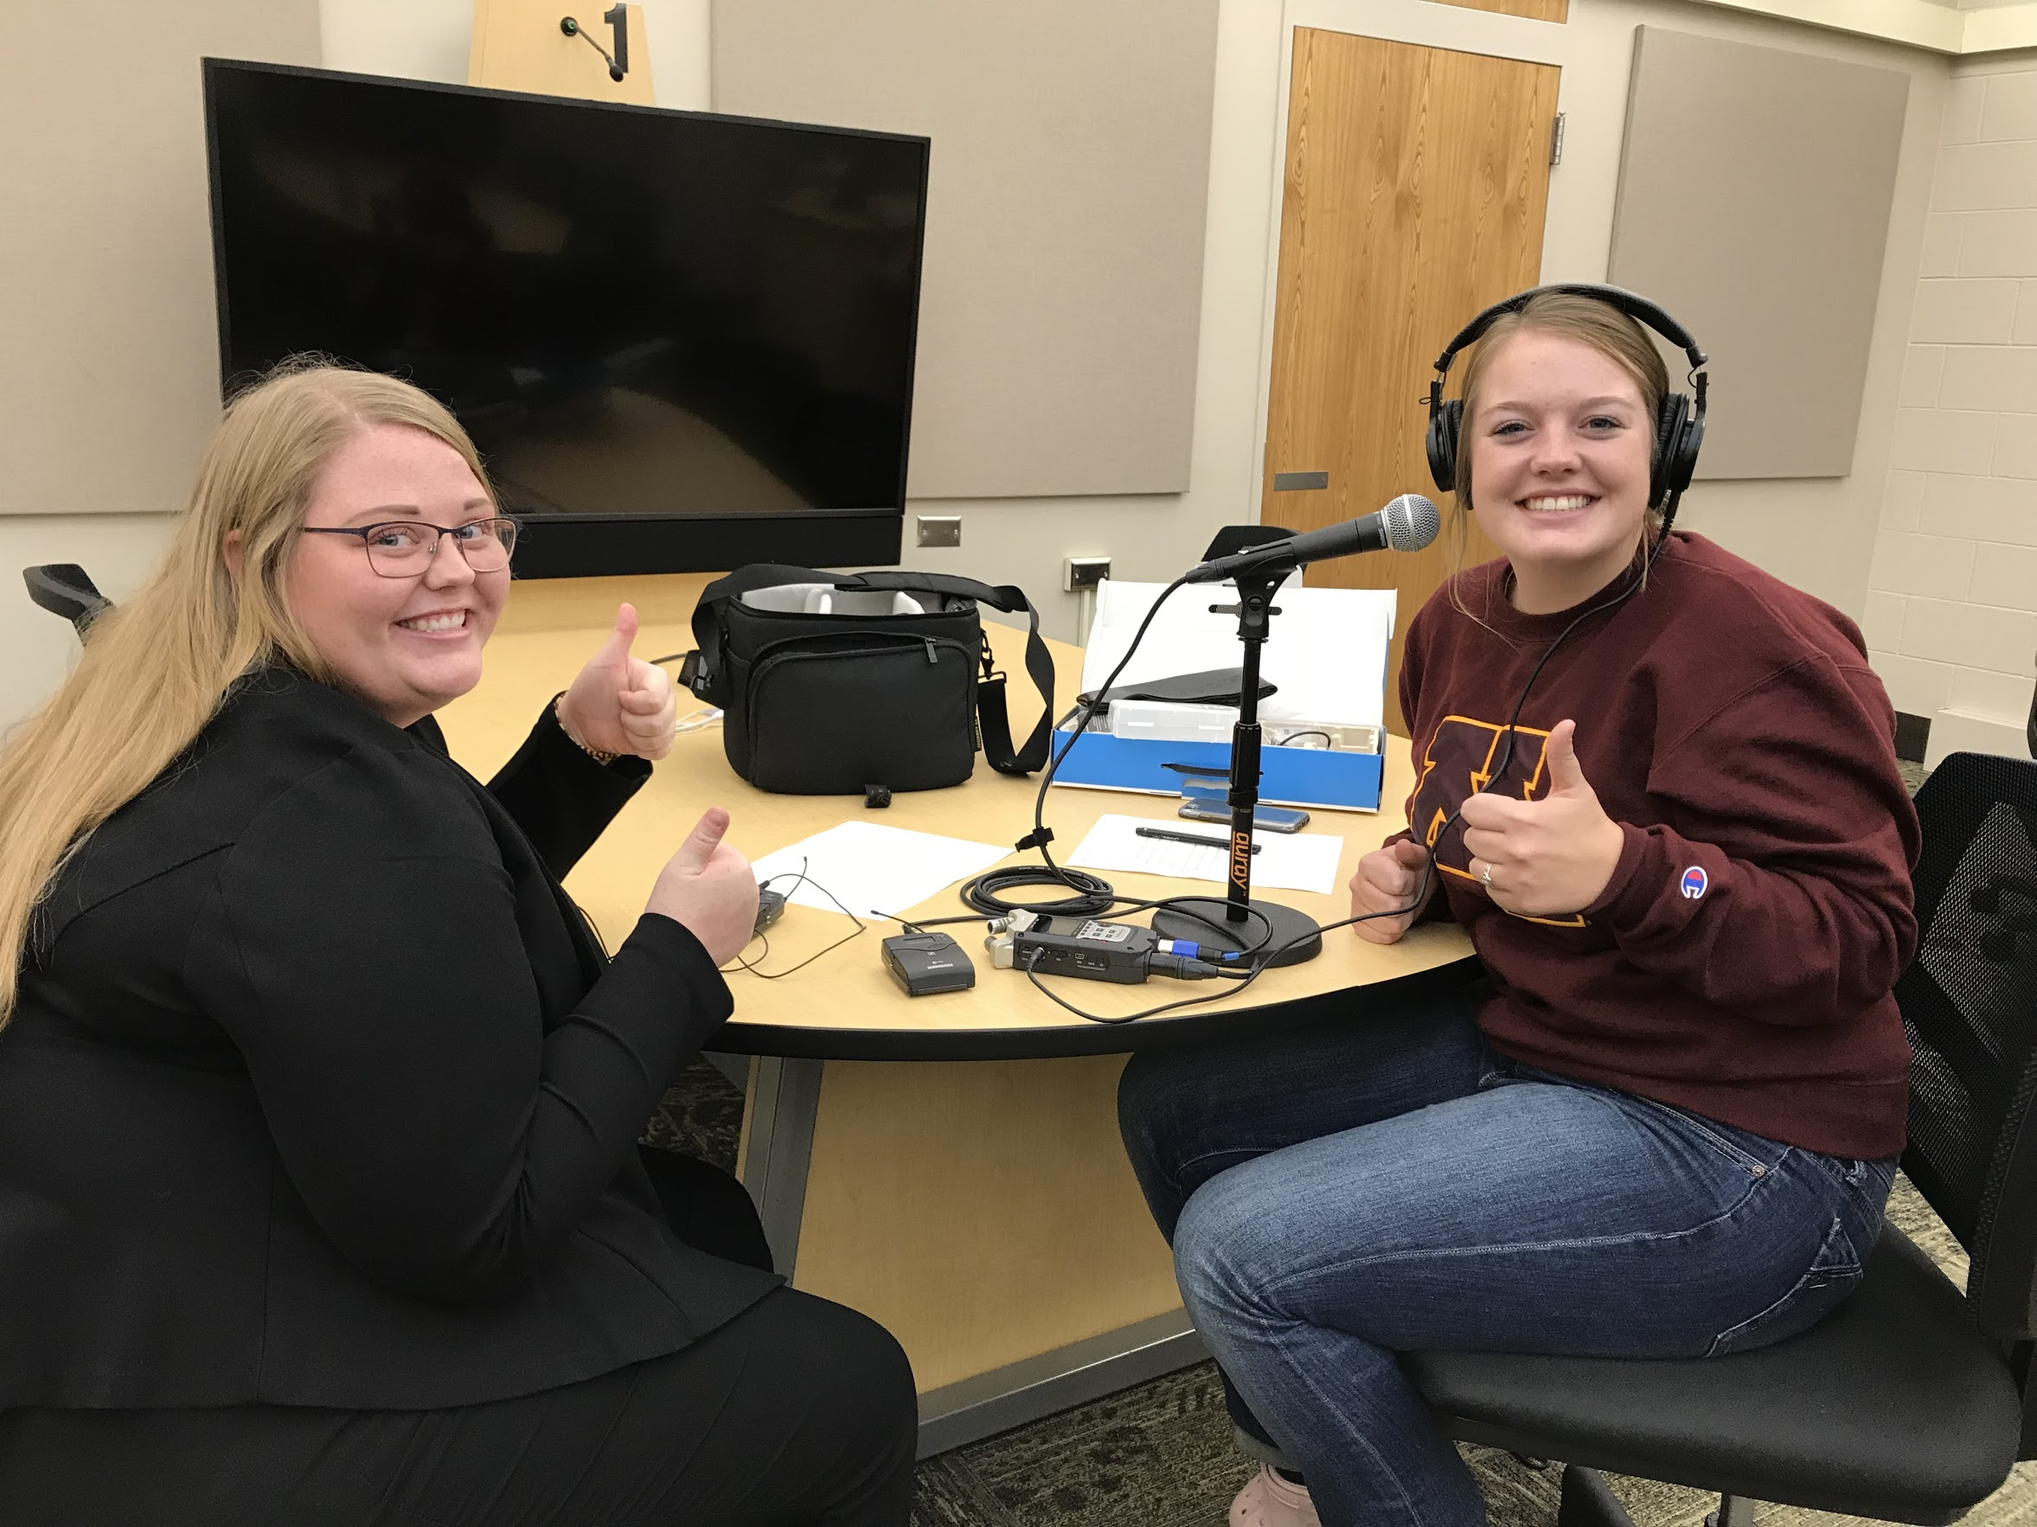
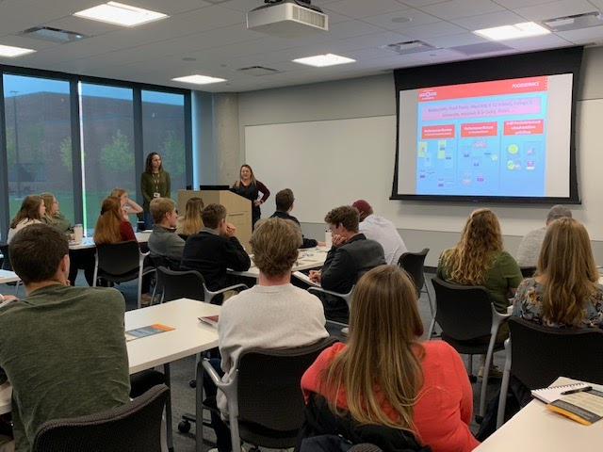
ACM Curriculum
Agricultural Communication & Marketing (ACM) degree prepares students to share science and stories about our food, agricultural and environmental systems with a wide range of audiences and organizations.
Communication
Business, Marketing, and Leadership
Ag, Food & Environmental Science
Develop effective communication skills, including speaking, writing, design, video production, social media, and campaign strategy
Deepen understanding of business, management, sales, marketing, and leadership concepts and practices
Strengthen knowledge, passion, and interest in technical food & agricultural subjects
1
2
3
Notes:
GS

Slide 4
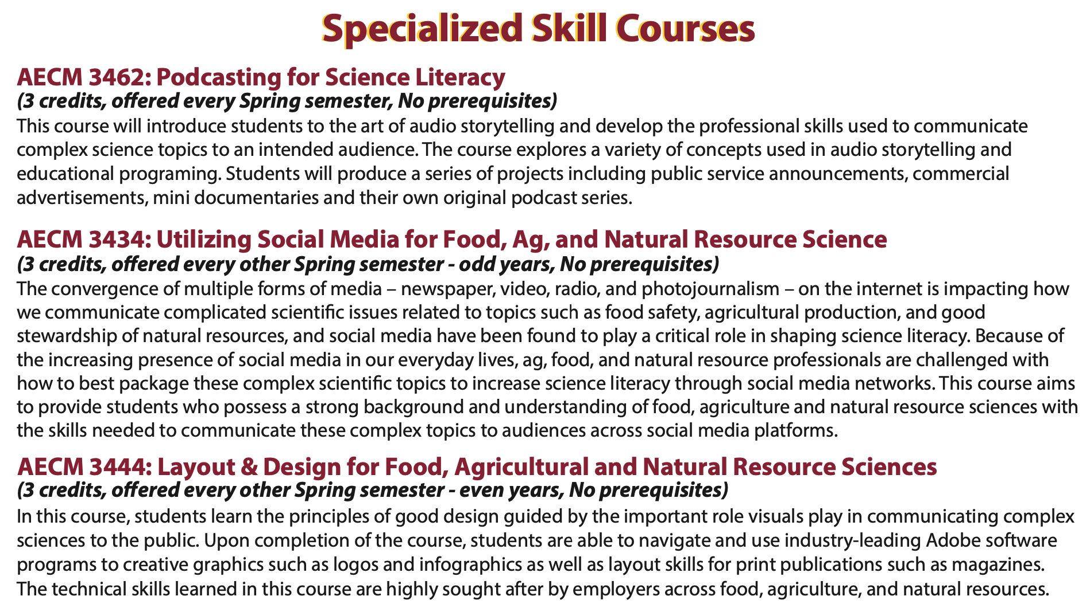
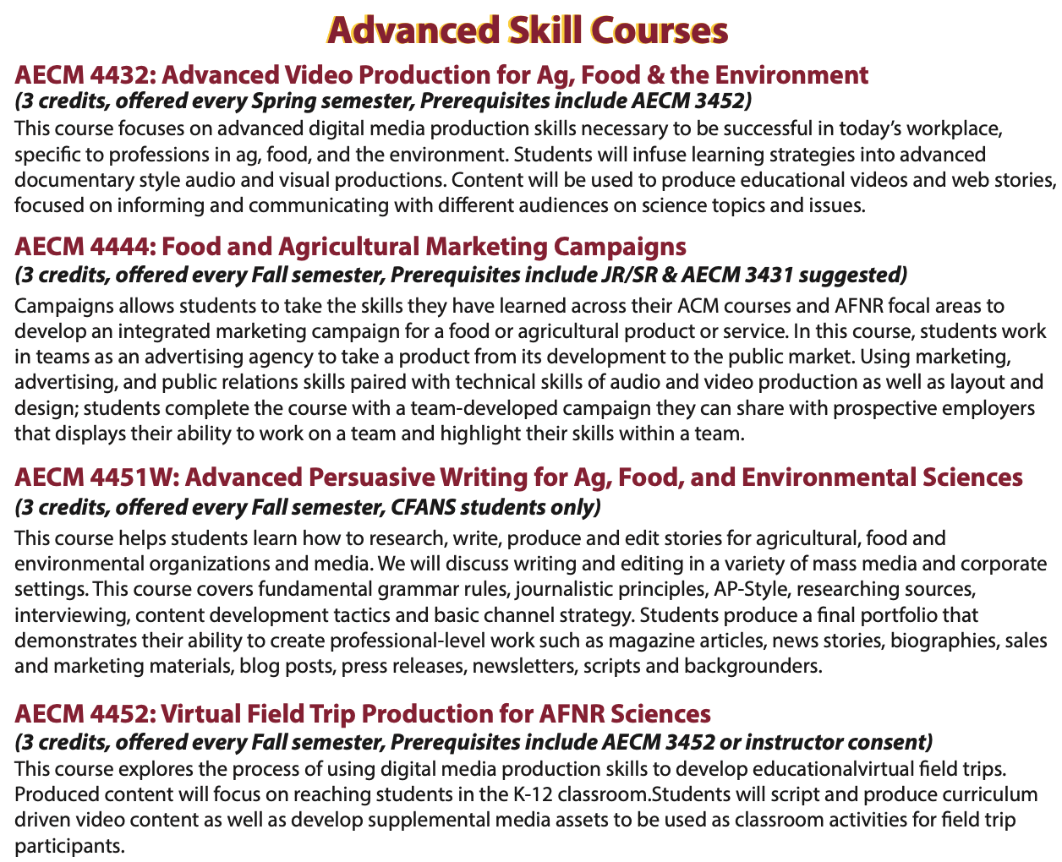
New and innovative course offerings
Notes:
GS

Slide 5
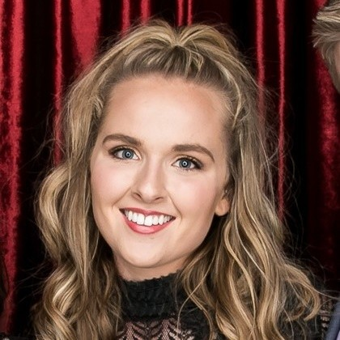
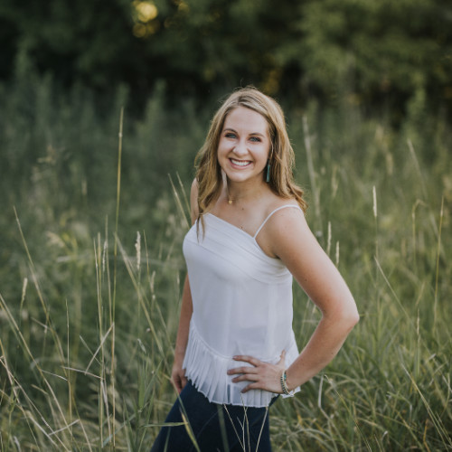
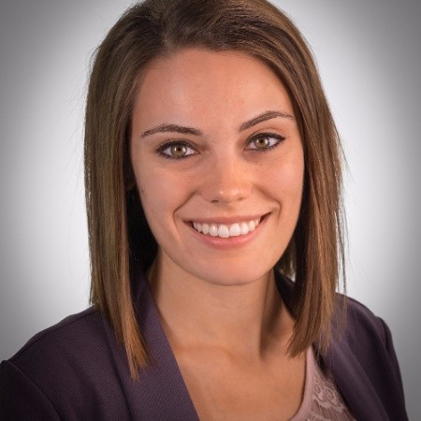
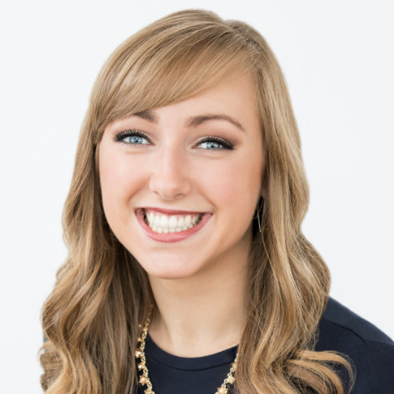
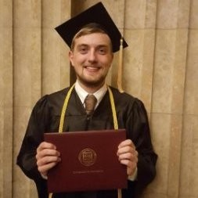
Job titles + types of employers
Abby Shea, PR Supervisor, broadhead
(Titles)
Public relations executive Magazine editor Communications specialist Sales training manager Corporate ag associate Extension educator Outreach coordinator Business analyst Marketing associate Social media manager Community relations associate HR Specialist
(Organizations)
Ag business organizations Ag magazines and publications Banks and financial institutions Extension service offices Government agencies Food companies Market research firms PR/Ad agencies Nonprofit organizations Research centers Universities Youth development organizations
Becky Church, Account Executive
Curious Plot
Sarah Hetke,
Digital Communications Consultant,
Compeer Financial
Madison Taylor, Partnership & Outreach Coordinator, Ferndale Market
Richard Ancel, Agronomy Associate at Winfield United
Notes:
Rebecca

Slide 6
Structure of Contest - synchronous and virtual!
Instructions for students on the day of the contest
On the day of the contest, join the Ag Com CDE Zoom meeting at 9:00am for welcome, orientation and team roll call.
Go to Agricast Ag Comm CDE Welcome Page: https://www.umnagricast.com/ag-comm-cde-welcome-page.html
Contest materials will available on that website starting at 9:00 AM .
The press conference and practicums will take place from 9:00 AM - 11:30 AM. Teams will then have a 30 min break for lunch, followed by the release of the quizzes on the UMN Agricast Website. Quizzes will be available from 12:00 PM - 1:00 PM.
Results will be shared with teachers soon after the contest concludes, and awards will be distributed during the Minnesota State FFA Convention. The winning team will represent Minnesota at the 2022 National FFA Convention.
Notes:
Rebecca - maybe don’t need this slide if talk through agenda on slide 7?

Slide 7
Agenda
Monday, December 13, 2021 - synchronous and virtual
Join the Ag Com CDE Zoom meeting at 9:00 AM for welcome, orientation and team roll call
9:00-9:15 AM | Welcome and Orientation via Zoom
Navigate to the Agricast Ag Comm CDE Welcome Page (https://www.umnagricast.com/ag-comm-cde-welcome-page.html) Contest materials will be available on this website starting at 9:00 AM
9:15-9:35 AM | Press Conference, Zoom Link
9:35-9:45 AM | Press Conference Questions, Zoom Link
10:00-11:30 AM | Practicum Work Time, Agricast Links will be open
11:30-Noon | Lunch Break
Noon-1:00 PM | Quizzes will be available. Submissions of quizzes need to be completed by 1:00 PM
Results will be shared with teachers soon after the contest concludes, and awards will be distributed during the Minnesota State FFA Convention in Spring.
Notes:
Rebecca

Slide 8
Materials needed
Contest is synchronous and virtual
Materials needed for the contest
Each school with need a team of 4, with practicum roles selected.
Each student will need a laptop with webcam and microphone.
Each student will need a Zoom account.
Each student will need paper and a pen or pencil.
Each student should be ready to take notes, ask questions, and think in both a strategic and creative manner!
Notes:
Rebecca

Slide 9
Components of Contest/Roles/Tips
Practicum Scenarios
All students will watch a pre-recorded press conference the day of the event. Then, the materials listed below will be created by members of your team based upon information shared during the press conference. Students should not create these items ahead of time.
A. Web design - Develop a WordPress site
B. Video producer - Create a 60-90 second video (file upload or url)
C. Journalistic writers - Write a feature story
D. Opinion writers - Write a blog post
After the practicum, students will complete two quizzes as individuals.
Quizzes (completed individually)
A. Editing Exercise
B. Communications Quiz
Notes:
Garrett

Slide 10
Agricast Site Walkthrough
AgriCast Walkthrough Video Link
Notes:
Troy

Slide 11
Practice Materials
https://www.umnagricast.com/ag-comm-cde-preparation.html
If you’re looking for more detailed descriptions about roles and responsibilities of each team member, go to the link above. You can view sample projects from years past for each role.
There are also practice quizzes and editing exams available as resources too!
Notes:
Troy

Slide 12
How to register your team
Register your team using this Google Form by December 1
Link to form: https://z.umn.edu/registerAgCom
Information needed for Google Form:
School, teacher’s name, and teacher’s email
Assigning students to each practicum: journalistic writer, opinion writer, web designer, video producer
Name, email, and year in school for each student participating
Notes:
Greta, Troy

